Slide 1

Image rendering in InstrumentStudio

Slide 2
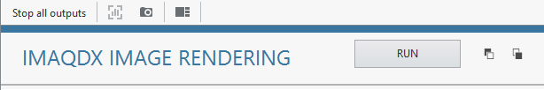
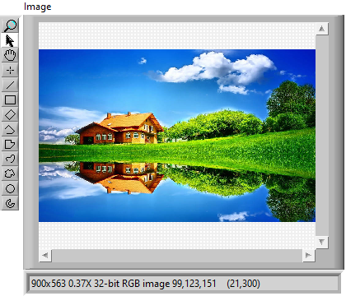

Image Streaming
Unpack Configuration
Trigger from IS
Acquire stream of images
75 ms per frame
Convert Image to gRPC supported type
Pack and send the result
gRPC streaming in
loop
LabVIEW Measurement
InstrumentStudio
Convert back to Image
+
Visualize in IS

Slide 3
Approximate Time Taken to transfer a frame
S.NO | Resolution (x*y) | Average Time Taken for sending each frame of image | Approach | Comment
1 | 1280x720 | 74 ms | Compressed string to byte array | 30 fps
2 | 1280x720 | 150 ms | U32 1D array
3 | 1280x720 | 750 ms | Json string
4 | 1920x1080 | 100 ms | Compressed string to byte array
5 | 1920x1080 | 300 ms | U32 1D array
6 | 1920x1080 | 1.3 s | Json string

